Slide 1
Creating a Benchmark for a Large-Scale Image Captioning Pipeline
Domino Data Lab
Field Data Science
April 2022

Slide 2

Field Data Science Practice
Assists at all phases of the project
Ideation
Research and development
Execution
Expert data scientists and field engineers help you leverage Domino for success
Dedicated team of field data scientists and data engineers focus on your success
We provide consultation services:
Best practices for data science on Domino
Developing Proof of Concepts and Minimum Viable Products
Execution of complex projects to solve business problems
Knowledge transfer upon project completion

Slide 3
The Problem
Deep Learning Pipelines take a long time to run
Deep learning on single GPUs can be slow

Slide 4
Deep Learning Pipelines take a long time to run…

Slide 5
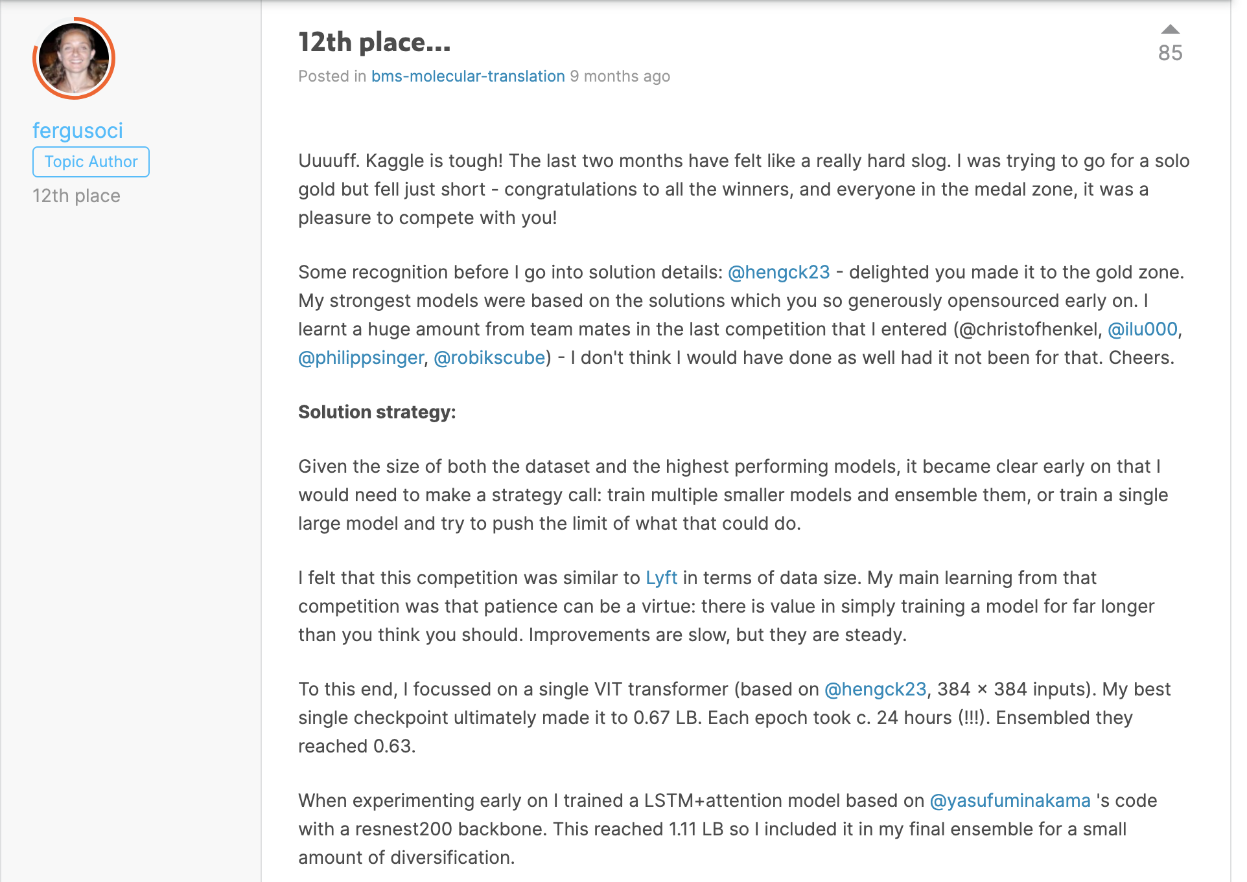

Slide 6


Slide 7
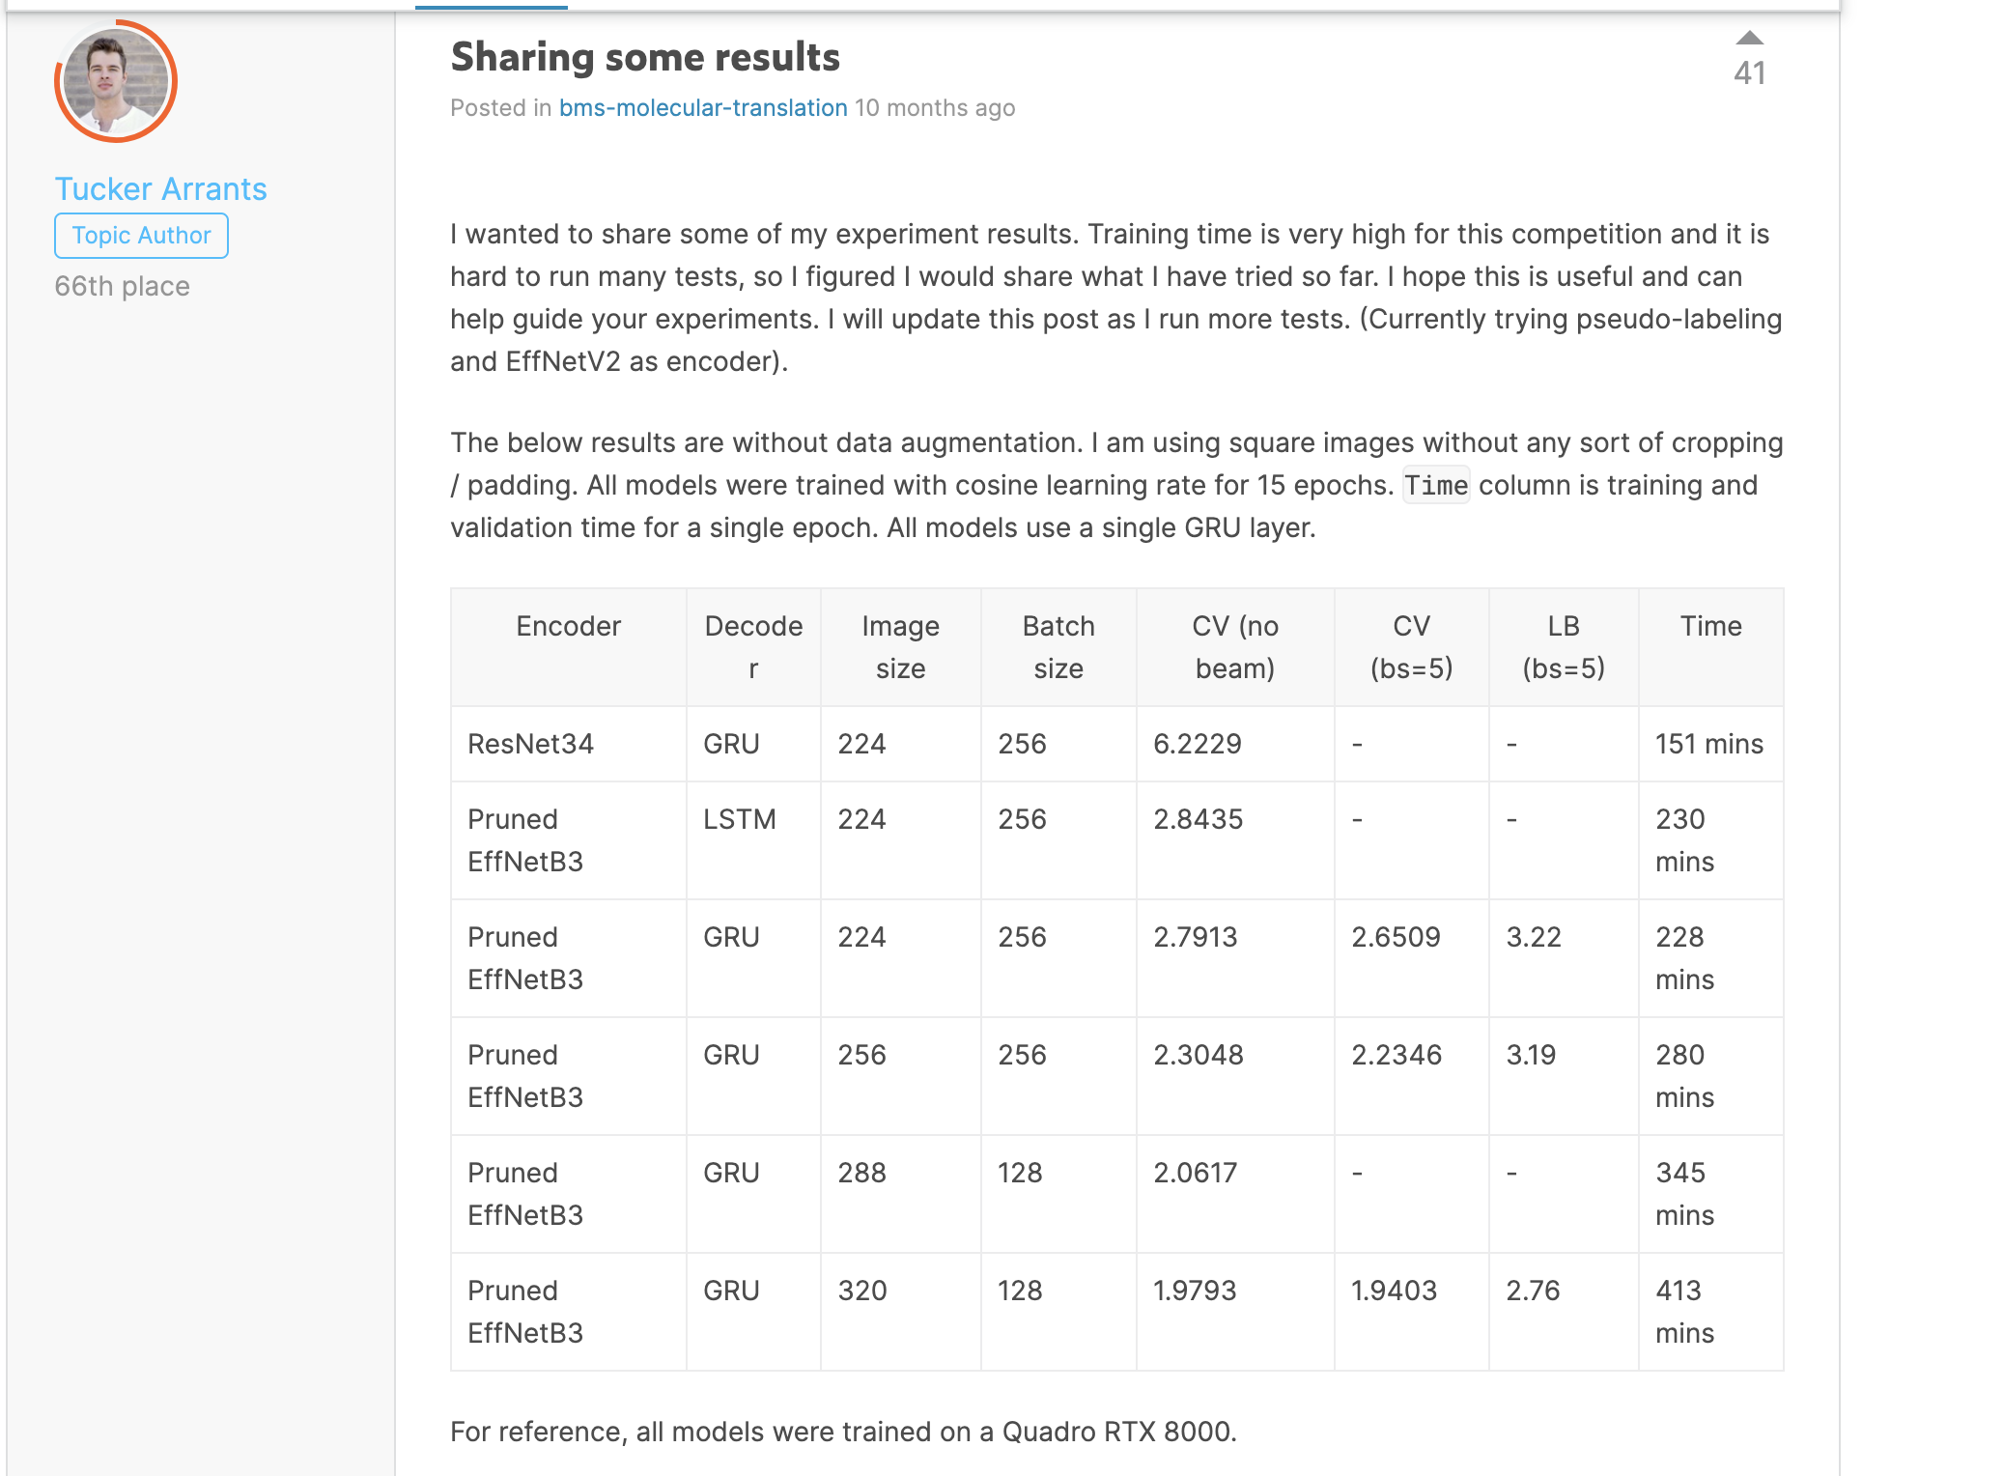

Slide 8
How we began to solve the problem of long-running training times…

Slide 9
Original Dataset and Derived Dataset
Original dataset supplied by BMS Kaggle competition
Data was speckled and difficult to read images
Derived dataset:
Used a computer vision pipeline to despeckle and sharpen images using custom pipeline
Only the derived dataset will be used for our experiments as training time was the goal of optimization

Slide 10
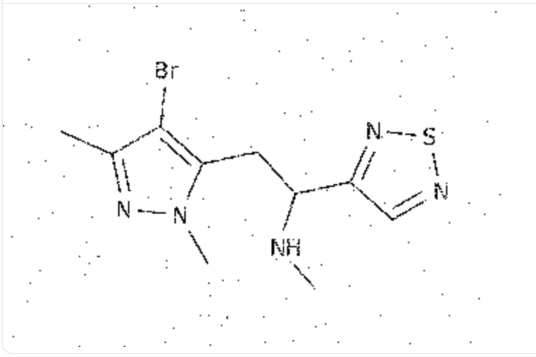
Example of an Original Image

Slide 11
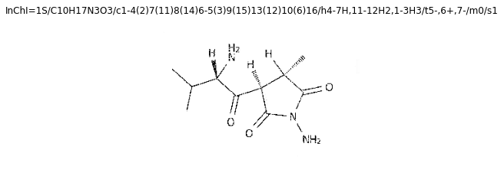
Example of Derived Data: Cleaned Image with Label

Slide 12
Process for the Challenge
Leveraging Domino to solve the challenge:
Understand the problem
Understand the data and its limitations
Design a solution
Test the solution
Improve the solution (in progress)

Slide 13

Solving the Challenge
Processes
Image Captioning
Deep Learning
Convolutional Neural Networks
Recurrent Neural Networks
Metrics:
Levenshtein Distance
Similarity Scores
Notes:
At a high level here’s the tools we used to solve the problem of captioning an image

Slide 14
How To Approach the Two-Sided Problem of Captioning Images? We thought of…
Caption Generation
Image Processing
Language Generation can occur at the:
Sentence level
Vocabulary level
Letter Level
LSTM (unidirectional or bidirectional)
Other seq-to-seq models
Transformers
Cleaning Dirty Images
Encoding images with their labels for a training dataset
Transfer Learning
Resnet152 (152 layers deep)
Resnet50 (50 layers deep)
Activation Functions
Beam Search

Slide 15
Experimental design: Deep Learning Pipeline
Process is Image Labeling
Label each of ~2.4 million images with its InChI label (see next slide for an image)
Use a deep learning pipeline
Encoder – Decoder method using vanilla neural nets
Encoder – Resnet50, final child layer removed, and features fed to Decoder
Decoder - LSTM (forward only)
Processes – NLP, Transfer Learning, Natural Language (Caption) Generation

Slide 16
Workflow
Clean all images (labeled and unlabeled)
Split data into training, validation and test sets
Process all images to create derived dataset
Process all InChI labels into a ‘vocabulary’ for the neural networks
Train the encoder model
Train the decoder model
Save the model for later inference

Slide 17
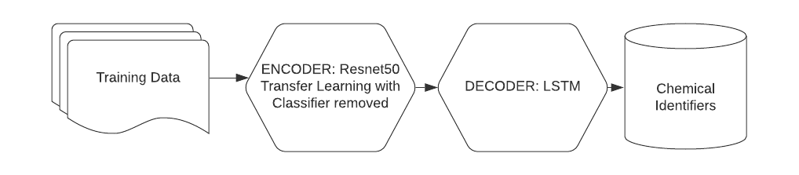
Workflow: Final Process Flow

Slide 18
Workflow
Encoder
Transfer learning
Resnet50
Use weights as output to LSTM
Decoder
LSTM model intakes weights from the Encoder

Slide 19
The science behind the techniques we used…

Slide 20
Neural Network Basics – Architecture
Basic components
Neurons and Layers
Neuron Types
Activation Functions
Logic Gates
Other Important Components
Weights and Bias
Input Patterning
Consists of an input layer and a layer that patterns the data to enter the neural network, i.e. acceptable to each neuron
Output Patterning
Converts the output data to a pattern a classifier can use
Classifier
Distributed Data Parallel

Slide 21

Transfer Learning Using CNN
The improvement of in new learning by transferring old learning to a new task
In terms of image analysis, it is used commonly to train computers to:
Label images with whole sentence captions
Pair images based on similarity
Visually recognize objects within images
Others

Slide 22
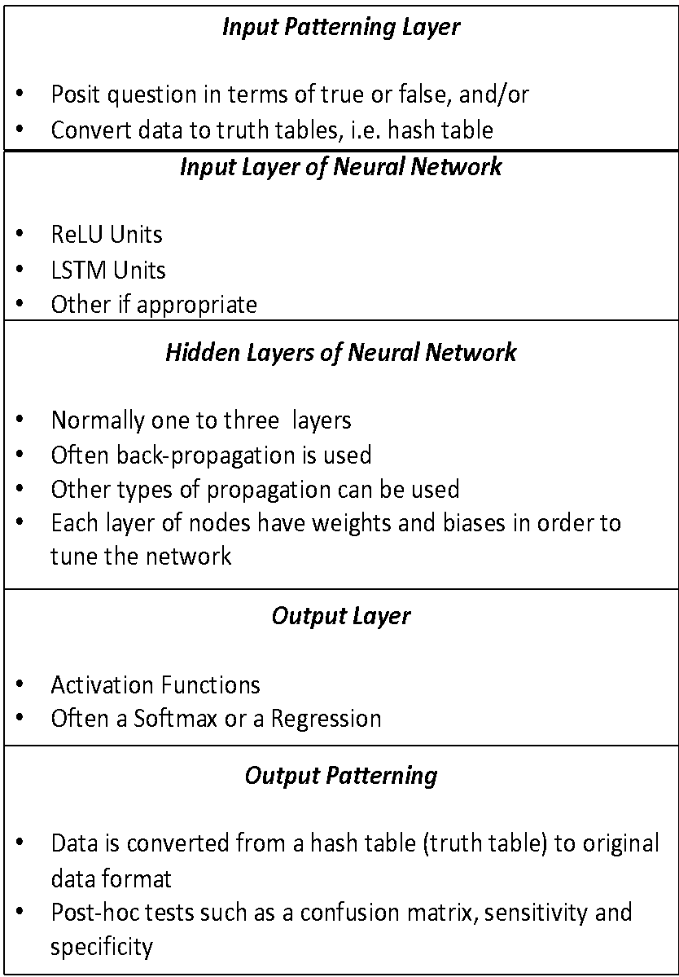
Generic Layers in a NN
Neural networks have a generic set of components
The illustration gives the basic neural network components
This pattern varies widely depending on the type of neural network

Slide 23
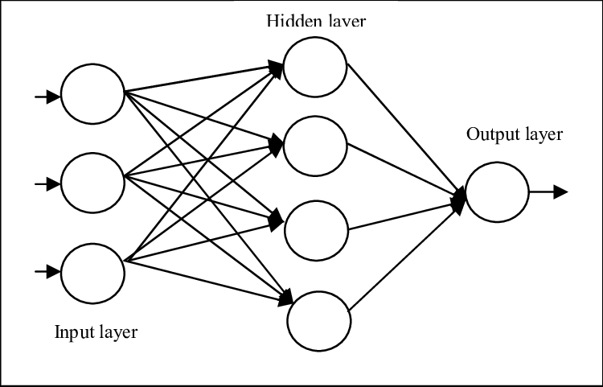
Closer Look at A Single Layer Feed Forward Architecture
Node
Node
Node
Node
Input Patterning
Node
Last Activation Function, e.g., Softmax
Node
Weights
Bias

Slide 24

Closer Look Convolutional Neural Network (CNN) Architecture
Used extensively in Computer Vision
Can be used with textual data as long as data is patterned to look like pixel data (more to come)

Slide 25
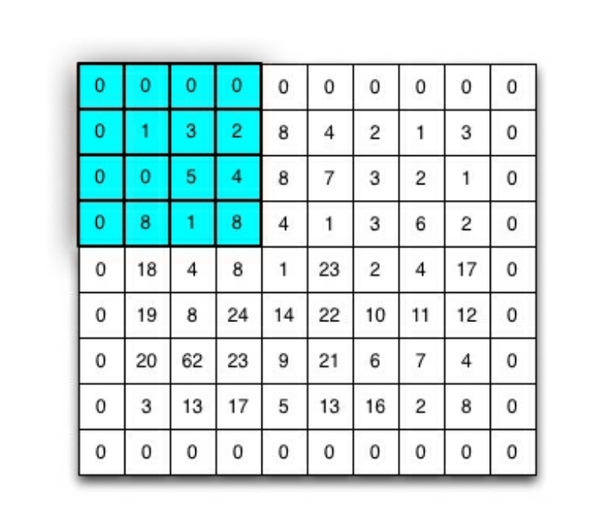
Convolutional Layer
Convolutional layers have weights between it and the prior layer/image grid
Padding size is responsible for the boarder in the image grid
The padding changes the size of the virtual image/filter
Each pixel on the convolutional layers is a weight
Total weights between layers are calculated by multiplying the filters sizes * number of filters

Slide 26
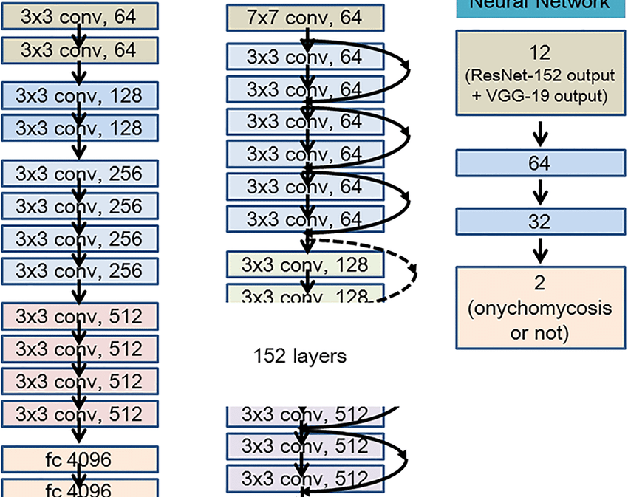
Resnet Model
Convolutional Neural Network
Trained on multiple convolutions ranging from 50 to 152 or more
Denoted as Resnet50 for fifty layers deep, Resnet152 for one hundred and fifty-two layers deep, etc.

Slide 27
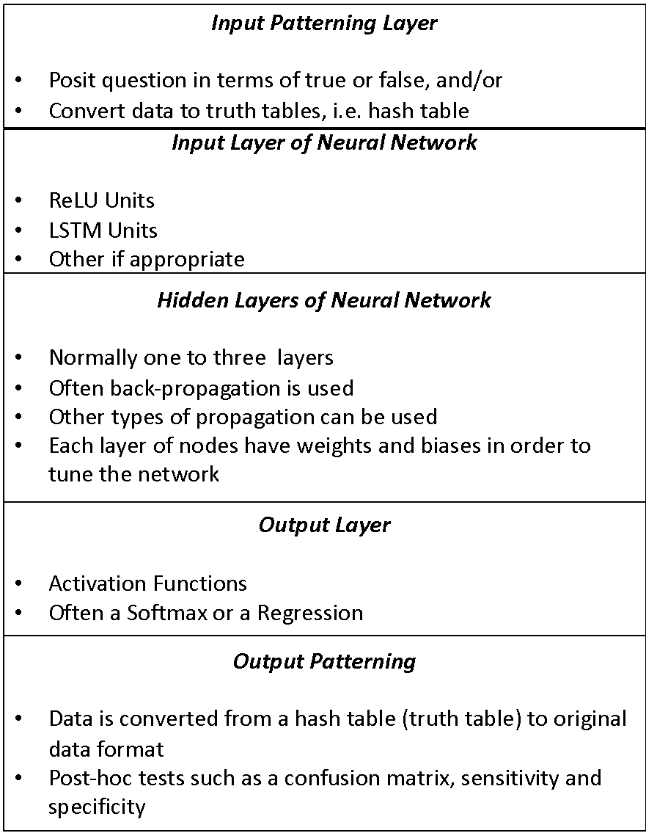
Layer Removed So Weights Can be fed to the LSTM
We removed one of the output patterning layers, the FC1 layer in order to keep the weights and feed those to the LSTM for caption generation

Slide 28

Natural Language Processing
Definition
The automated manipulation and processing of speech, text, parts of speech into a format computers can assess
Use Cases
Chatbots
Language Generation applications
Alexa, Google Assistant
Many others
Our Use Case
Create Final Chemical Labels

Slide 29

Long-term, Short-term Memory
One method to generate natural-sounding language
Other methods include things like GTP3 which is a language embedding algorithm
Our purpose was to simply make a correct caption choice, and to make the process work quickly
We decided to use the seq-to-seq type of method
We used a uni-directional LSTM to keep things simple
Bi-directional LSTMS are often used for NLG

Slide 30
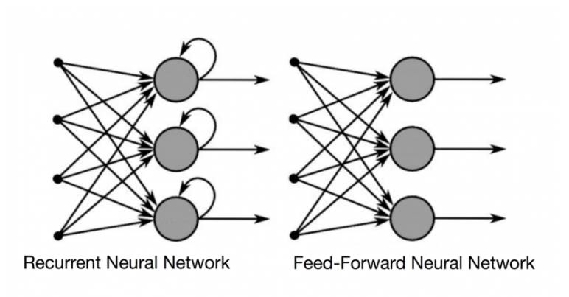
Neural Network (RNN) Architecture

Slide 31
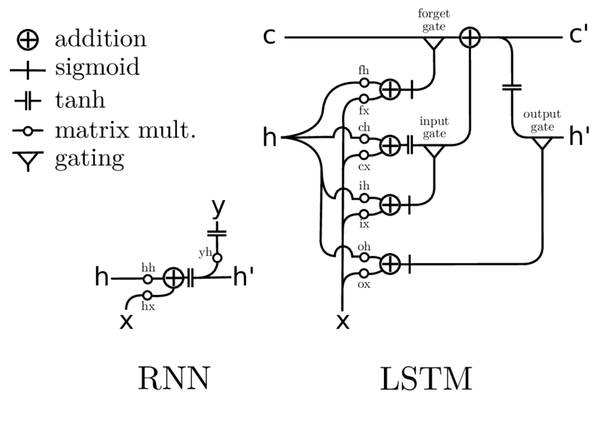
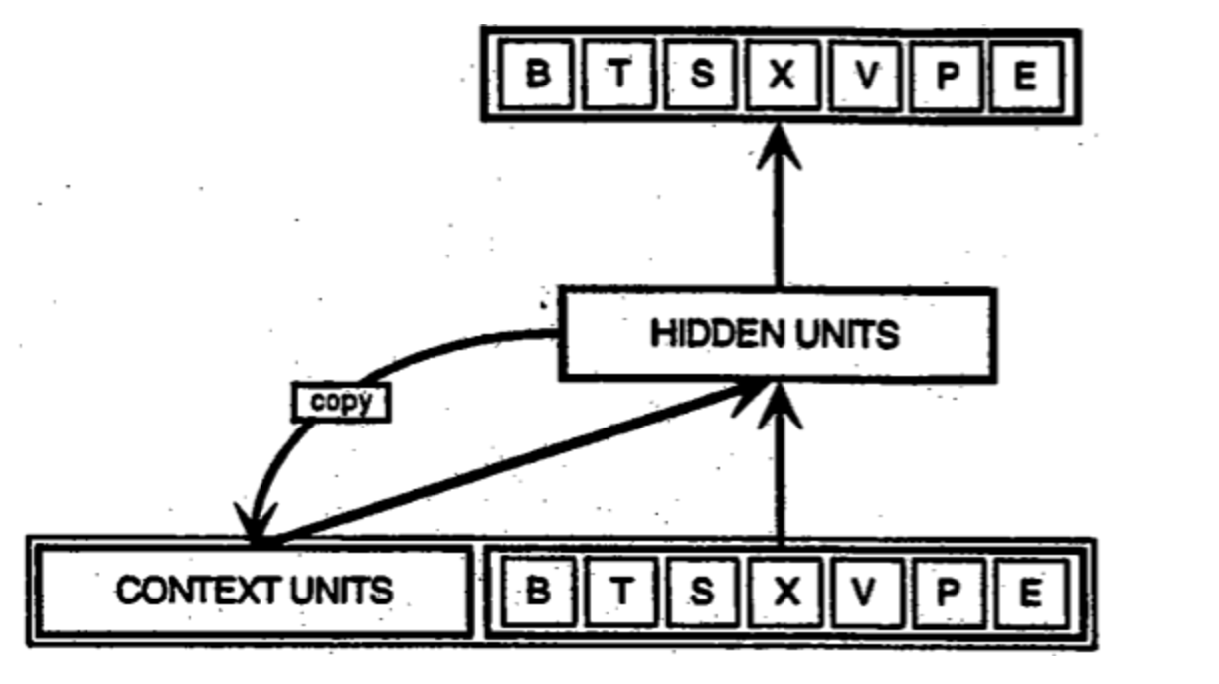
Neural Nets & LSTM
https://deeplearning4j.org/lstm
Advances in Humanoid Control & Percentpion, Stollenga, May 2016
Notes:
Figure 7.4. RNN and LSTM A graphical representation of the RNN and LSTM networks are shown. The inputs are denoted by x, the hidden units by h, and the output units by y. For the LSTM, the hidden unit h functions as the output unit. The accent ( ) denotes a value in the next time step h = h t+1 ; otherwise the value is current h = h t . The RNN has a much simpler structure and lacks gating operations. The LSTM has several gating mechanisms, allowing it to propagate information efficiently over long periods of time. If the forget gate is on and the input gate off, the line from c to c essentially copies information. By switching on the input gate, information can be added to c , and by switching off the forget gate, the information from c will not reach c as is forgotten. These gating mechanisms let the LSTM control the flow of information and propagate it over long time ranges.

Slide 32
Now that we have our deep learning techniques…how will we apply them?

Slide 33
How To Approach the Two-Sided Problem? We thought of…
Language Generation
Image Processing
Language Generation can occur at the:
Sentence level
Vocabulary level
Letter Level
LSTM (unidirectional or bidirectional)
Other seq-to-seq models
Transformers
Cleaning Dirty Images
Encoding images with their labels for a training dataset
Transfer Learning
Resnet152 (152 layers deep)
Resnet50 (50 layers deep)
Activation Functions
Beam Search

Slide 34
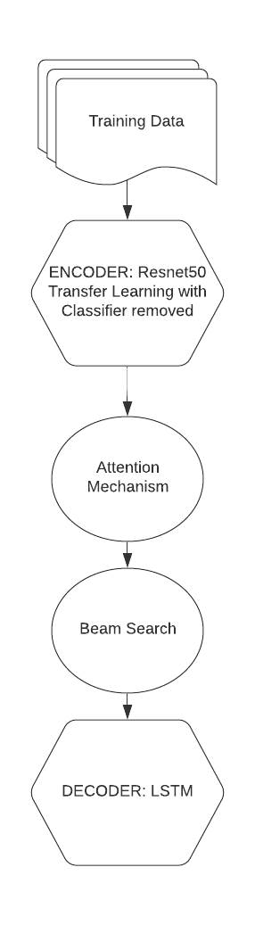
Algorithmic Architecture – Our Original Plan
Training data – cleaning using a CV pipeline that included OpenCV
Encoder – transfer learning using Resnet50
Attention mechanism –
Beam Search – increasingly narrows the attention mechanism to focus on specific portions of the image
Decoder – RNN/LSTM that ‘decodes’ the sentence (i.e., InChI label)

Slide 35
Challenge
Attention mechanism was complex and added to the code base without necessarily adding to the outcome
Beam Search is a new technique, and we didn’t know whether it would help or not
Decided to first try a canonical image captioning pipeline, and then move on to a more challenging pipeline if needed.

Slide 36
Algorithmic Architecture – Our Simplified Plan
Training data – cleaning using a CV pipeline that included OpenCV
Encoder – transfer learning using Resnet50
Decoder – RNN/LSTM that ‘decodes’ the sentence (i.e., InChI label)

Slide 37
Now that we have our deep learning pipeline planned what’s next?

Slide 38
Tasks
Clean Images
Speckle Removal
Image Sharpening
Tools: OpenCV
Process Text
Tokenization
Vocabulary
Tools: TorchText
Encode Images & Labels
Transfer learning
Resnet50 or 152 (indicates layers deep for CNN)
Decode Labels
LSTM
Natural Language Generation of 'Sentences'
First caption is heaviest weighted
First caption is taken as final answer

Slide 39
Tasks
Clean all images (labeled and unlabeled) using computer vision library OpenCV
Split data into training, validation and test sets
Process all images into Pytorch tensors
Process all InChI labels into a ‘vocabulary’ for the neural networks
Train the encoder model - Resnet50 model weights with final classifier removed
Train the decoder model – RNN/LSTM with a linear output layer
Infer all InChI Labels
Calculate Levenschtein scores (to determine difference from correct label to true label) for validation set
Create inference in final submission format

Slide 40
What the results looked like…

Slide 41
Definitions
Ray – ‘workers’ – the executors (pod which requests resources - CPUs or GPUs) that do the calculations for the project
Pytorch – ‘workers’ – threads that encompass individual executions of the code
An example is a set up with 4 pytorch workers that has 5 cpus each would use a total of 20 cpus.

Slide 42
Experimental Design: Training and Testing
Hardware | Number of Epochs | Number of Executors (Ray) | Number of Workers (Pytorch) | Number of Repeats
g4dn-16xlarge | 1 | 0 | 1 | 3X
G4dn-16xlarge | 1 | 5 | 4 | 3X
r5-8xlarge | 1 | 20 | 20 | 3X
r5-8xlarge | 1 | 10 | 4 | 3X
r5-8xlarge | 1 | 5 | 4 | 3X
Run experiments 3x, inference 1x per model trained
Calculate Levenschtein scores on validation data
High memory CPU and GPU with Shared Memory not rationed

Slide 43

Preliminary Results
Performance with distributed computing using CPUs in as little as 8 hours for the entire ~2.4 million + images, Repeat 3X completed
GPU (needs to be verified) takes anywhere between a week and 9 hours (will discuss type of GPU matters)
Single CPU takes over 24 hours

Slide 44
Benchmark: Training with 20 Workers
Example Log data
Started epoch: 2022-02-27 10:25:24 :
Finished epoch: 2022-02-27 06:45:00 : {'num_samples': 4826530.0, 'epoch': 1.0, 'loss': tensor(3.7960, requires_grad=True), 'profile': {'mean_train_epoch_s': 29972.976516485214}}

Slide 45
Our Preliminary Results on ~2.4 million images
Hardware | Number of Epochs | Number of Executors (Ray) | Number of Workers (Pytorch) | Cost per hour | Time to complete one Epoch | Total Cost on AWS
g4dn-16xlarge | 1 | 0 | 1 | $4.352 | ~ 9 hours, ~28 hours (varies widely) | ~$39 ~$122
r5-8xlarge | 1 | 20 | 20 | $2.016 | ~ 8 Hours 19 Minutes (2X) | ~$322.56
r5-8xlarge | 1 | 10 | 4 | $2.016 | 14 hours, 2 minutes | ~$282.24
r5-8xlarge | 1 | 5 | 4 | $2.016 | 2 days, 11 hours (1X) | ~$594.72
GPU method is a conventional training method where only 1 GPU is leveraged.
CPU method leverages distributed computing and Ray
Hybrid cloud CPU or GPU utilization would save money versus solely utilizing cloud
Notes:
Original code for image captioning was adapted from “Modern Computer Vision with PyTorch. V Kishore Ayyadevara and Yeshwanth Reddy, Packt Publishing 2020.
CPU is $2.016 per hour
GPU is $4.352 per hour

Slide 46
So how well did the trained models do inference?

Slide 47
Challenges
Predictions were giving full ‘sentences’ when we needed just a one-word answer
Solution – limit to one token per image during the training stage, and then in output truncate to one token
Use Levenschtein Scores to determine how close we got to the actual label using our validation data (created from the training dataset)
Levenschtein Scores are a measure of the number of letters which need to be modified for two strings to match

Slide 48
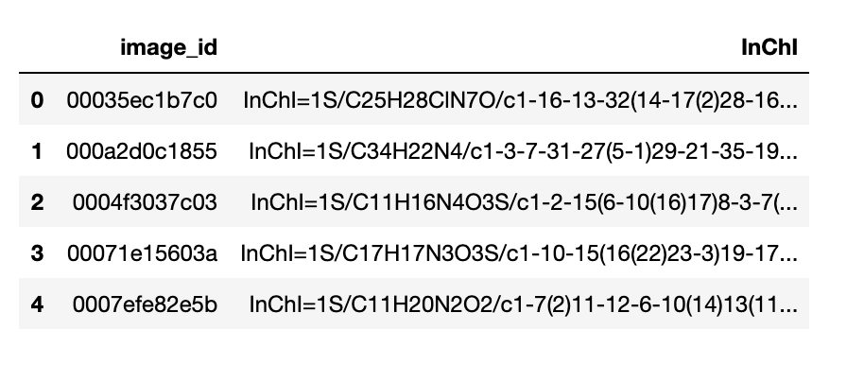
Outputs – Test Image Predictions

Slide 49
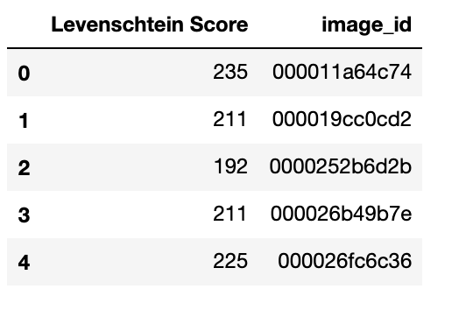
Outputs – Validation Set Levenschtein Scores

Slide 50
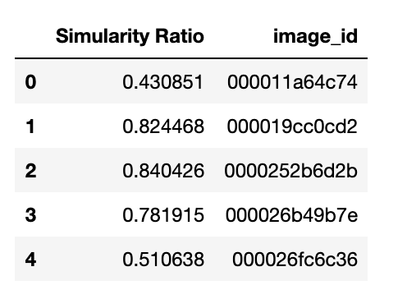
Outputs - Similarity Scores

Slide 51
Next Steps
Running repeats on Ray using the full dataset
Ensuring repeats appropriate number of times
Try running through more epochs
Assess performance by measuring Levenschtein scores from a fully trained model’s predictions over the validation dataset
Scaling training with GPUs using distributed training on Ray

Slide 52
Thank you! Keep in touch.
Domino Data Lab
Jennifer D. Davis, Ph.D.
Staff Field Data Scientist
jennifer.davis@dominodatalab.com
Code to be deposited in public repository soon!

